Slide 1



Global Terrorism Dataset
View in Power BI
Last data refresh:
5/24/2024 2:49:50 PM UTC
Downloaded at:
12/27/2024 9:58:16 AM UTC

Slide 2
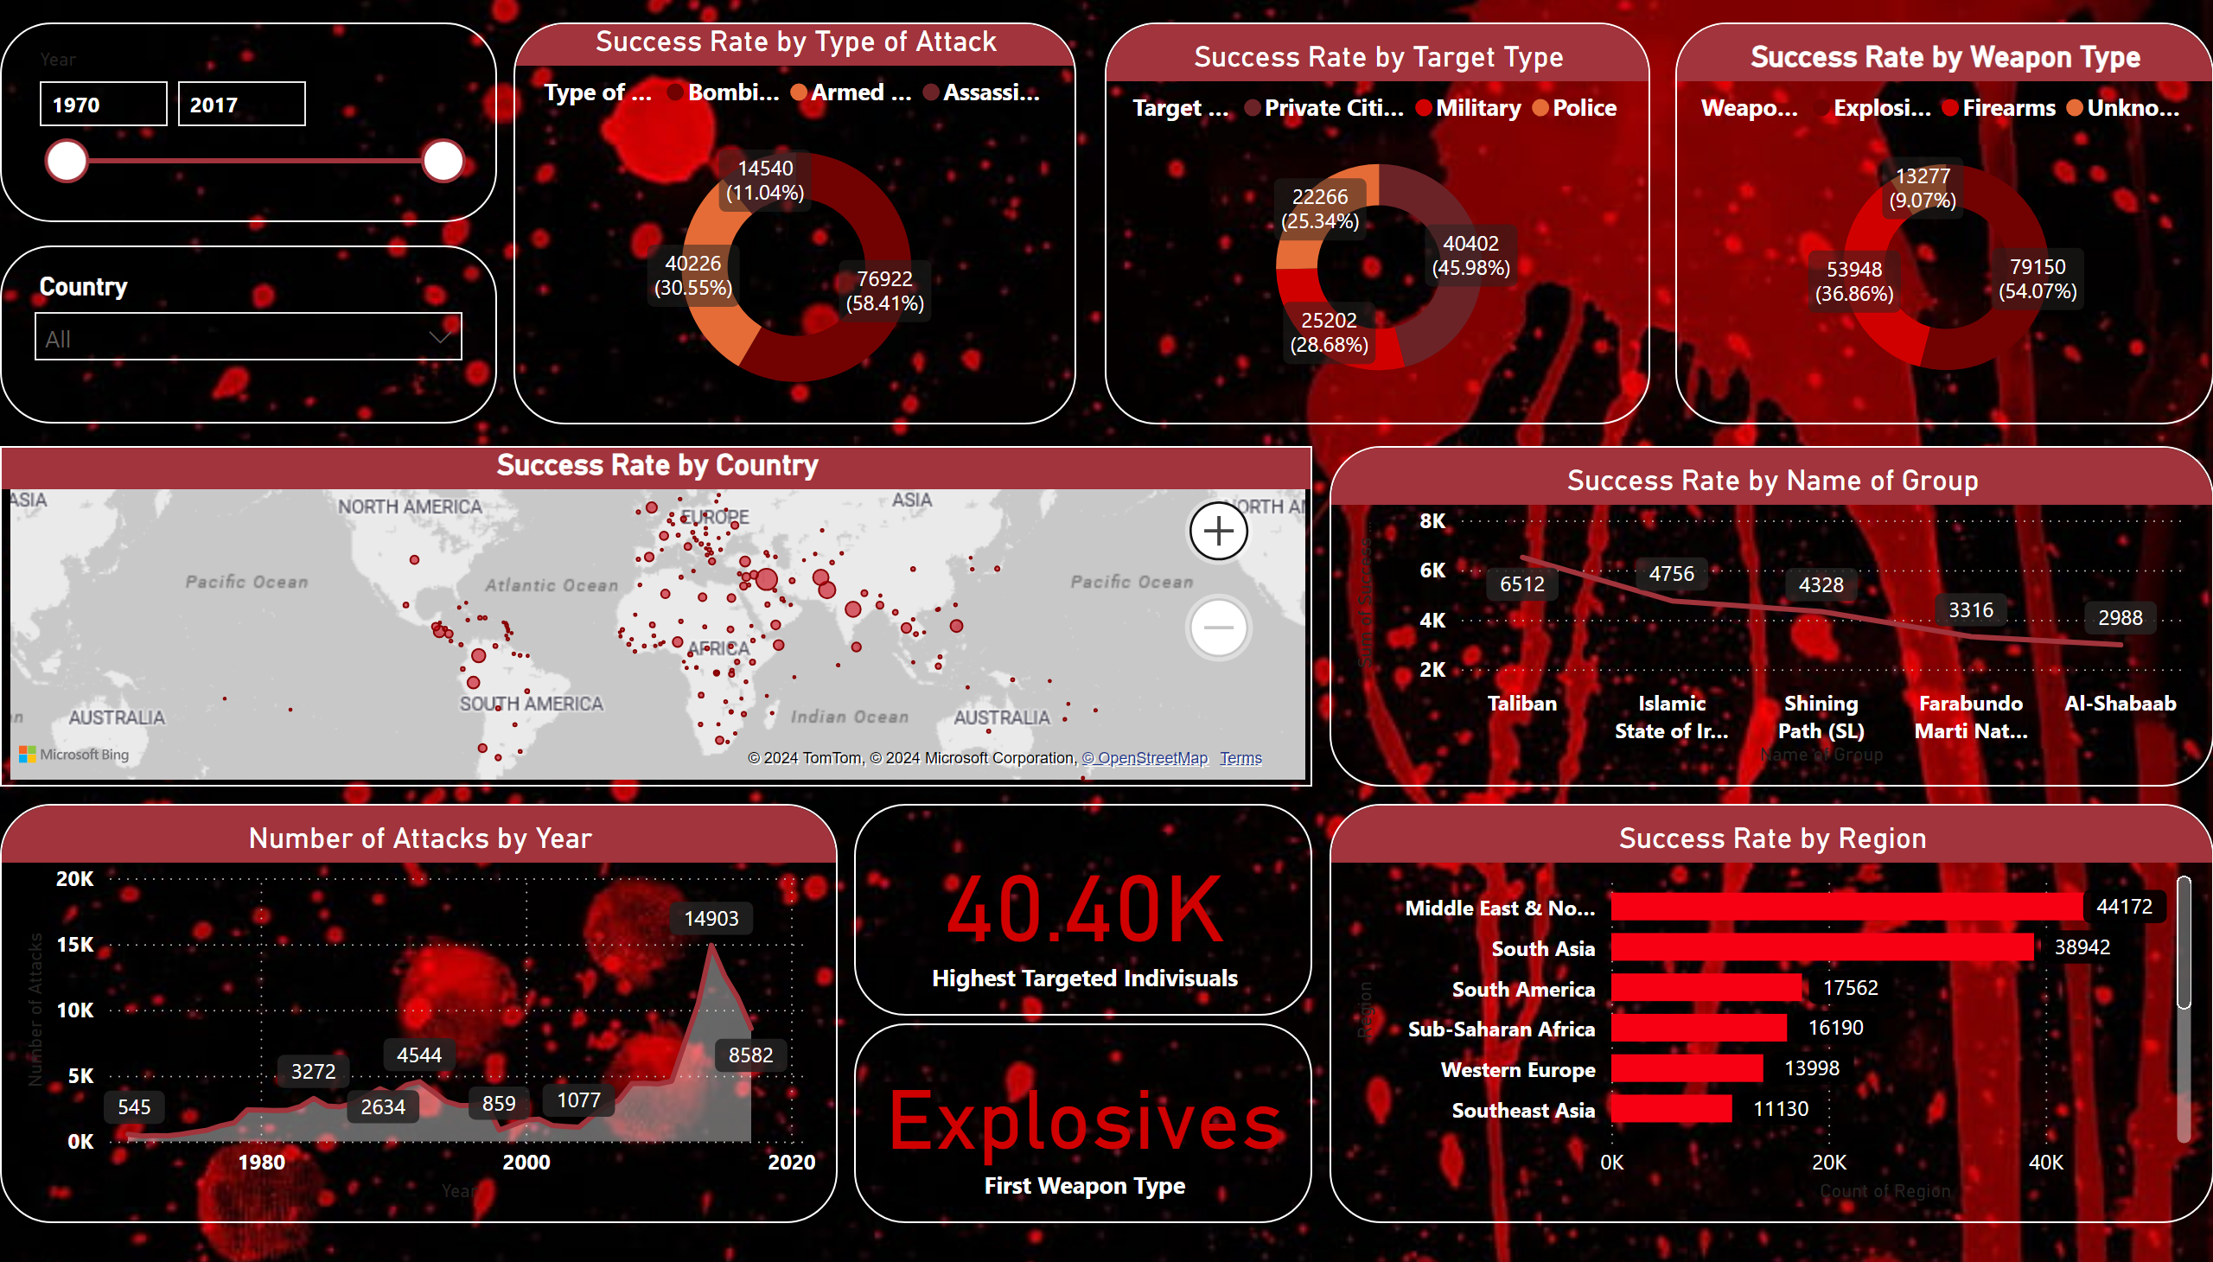
Global Terrorism Report
Notes:
card
No alt text provided
Success Rate by Region
No alt text provided
Success Rate by Weapon Type
No alt text provided
Success Rate by Target Type
No alt text provided
card
No alt text provided
areaChart
No alt text provided
slicer
No alt text provided
Success Rate by Name of Group
No alt text provided
slicer
No alt text provided
Success Rate by Country
No alt text provided
Success Rate by Type of Attack
No alt text provided

